Slide 1
CSE 465 Lecture 2
Python

Slide 2
Hello Python
SUFFIXES = {1000: ['KB', 'MB', 'GB', 'TB', 'PB', 'EB', 'ZB', 'YB'],
1024: ['KiB', 'MiB', 'GiB', 'TiB', 'PiB', 'EiB', 'ZiB', 'YiB']}
def approximate_size(size, a_kilobyte_is_1024_bytes=True):
'''Convert a file size to human-readable form.
Keyword arguments:
size -- file size in bytes
a_kilobyte_is_1024_bytes -- if True (default), use multiples of 1024
if False, use multiples of 1000
Returns: string
'''
if size < 0:
raise ValueError('number must be non-negative')
multiple = 1024 if a_kilobyte_is_1024_bytes else 1000
for suffix in SUFFIXES[multiple]:
size /= multiple
if size < multiple:
return '{0:.1f} {1}'.format(size, suffix)
raise ValueError('number too large')
if __name__ == '__main__':
print(approximate_size(1000000000000, False))
print(approximate_size(1000000000000))

Slide 3
Enough to Understand the Code
Indentation matters to meaning the code
Block structure indicated by indentation
The first assignment to a variable creates it
Dynamic typing: no declarations, names don’t have types, objects do
Assignment uses = and comparison uses ==
For numbers + - * / % are as expected.
Use of + for string concatenation.
Use of % for string formatting (like printf in C)
Logical operators are words (and,or,not) not symbols
The basic printing command is print

Slide 4
Basic Datatypes
Integers (default for numbers)
z = 5 // 2 # Answer 2, integer division
Floats/Doubles
x = 3.456
Strings
Can use ”…" or ’…’ to specify, "foo" == 'foo’
Unmatched can occur within the string “John’s” or ‘John said “foo!”.’
Use triple double-quotes for multi-line strings or strings than contain both ‘ and “ inside of them: “““a‘b“c”””
Boolean
True
False

Slide 5
Whitespace
Whitespace is meaningful in Python, especially indentation and placement of newlines
Use a newline to end a line of code
Use \ when must go to next line prematurely
No braces {} to mark blocks of code, use consistent indentation instead
First line with less indentation is outside of the block
First line with more indentation starts a nested block
Colons start of a new block in many constructs, e.g. function definitions, then clauses

Slide 6
Comments
Start comments with #, rest of line is ignored
Can include a “documentation string” as the first line of a new function or class you define
Development environments, debugger, and other tools use it: it’s good style to include one
def fact(n):
“““fact(n) assumes n is a positive integer and returns factorial of n.””” assert(n>0)
return 1 if n==1 else n*fact(n-1)

Slide 7
Naming Rules
Names are case sensitive and cannot start with a number. They can contain letters, numbers, and underscores.
bob Bob _bob _2_bob_ bob_2 BoB
There are some reserved words:
and, assert, break, class, continue, def, del, elif, else, except, exec, finally, for, from, global, if, import, in, is, lambda, not, or, pass, print, raise, return, try, while

Slide 8
Naming conventions
The Python community has these recommended naming conventions
joined_lower for functions, methods and, attributes
joined_lower or ALL_CAPS for constants
StudlyCaps for classes
camelCase only to conform to pre-existing conventions
Attributes: interface, _internal, __private

Slide 9
Sequence Types
Sequences are containers that hold objects
List
Tuple
String
Finite, ordered, indexed by integers
Tuple: (1, “a”, [100], “foo”)
An immutable ordered sequence of items
Items can be of mixed types, including collection types
Strings: “foo bar”
An immutable ordered sequence of chars
Conceptually very much like a tuple
List: [“one”, “two”, 3]
A Mutable ordered sequence of items of mixed types

Slide 10
Similar Syntax
All three sequence types (tuples, strings, and lists) share much of the same syntax and functionality.
Key difference:
Tuples and strings are immutable
Lists are mutable
The operations shown in this section can be applied to all sequence types
most examples will just show the operation performed on one

Slide 11
Sequence Types 1
Define tuples using parentheses and commas
>>> tu = (23, ‘abc’, 4.56, (2,3), ‘def’)
Define lists are using square brackets and commas
>>> li = [“abc”, 34, 4.34, 23]
Define strings using quotes (“, ‘, or “””).
>>> st = “Hello World”
>>> st = ‘Hello World’
>>> st = “””This is a multi-line
string that uses triple quotes.”””

Slide 12
Sequence Types 2
Access individual members of a tuple, list, or string using square bracket “array” notation
Note that all are 0 based…
>>> tu = (23, ‘abc’, 4.56, (2,3), ‘def’)
>>> tu[1] # Second item in the tuple.
‘abc’
>>> li = [“abc”, 34, 4.34, 23]
>>> li[1] # Second item in the list.
34
>>> st = “Hello World”
>>> st[1] # Second character in string.
‘e’

Slide 13
Positive and negative indices
>>> t = (23, ‘abc’, 4.56, (2,3), ‘def’)
Positive index: count from the left, starting with 0
>>> t[1]
‘abc’
Negative index: count from right, starting with –1
>>> t[-3]
4.56

Slide 14
Slicing: Return Copy of a Subset
>>> t = (23, ‘abc’, 4.56, (2,3), ‘def’)
Returns copy of container with subset of original members. Start copying at first index, and stop copying before the second index
>>> t[1:4]
(‘abc’, 4.56, (2,3))
You can also use negative indices
>>> t[1:-1]
(‘abc’, 4.56, (2,3))

Slide 15
Slicing: Return Copy of a Subset
>>> t = (23, ‘abc’, 4.56, (2,3), ‘def’)
Omit first index to make a copy starting from the beginning of container
>>> t[:2]
(23, ‘abc’)
Omit second index to make a copy starting at 1st index and going to end of the container
>>> t[2:]
(4.56, (2,3), ‘def’)

Slide 16
Copying the Whole Sequence
[ : ] makes a copy of an entire sequence
>>> t[:]
(23, ‘abc’, 4.56, (2,3), ‘def’)
Note the difference between these two lines for mutable sequences
>>> l2 = l1 # Both refer to same ref,
# changing one affects both
>>> l2 = l1[:] # Independent copies, two refs

Slide 17
The ‘in’ Operator
Boolean test whether a value is inside a container:
>>> t = [1, 2, 4, 5]
>>> 3 in t
False
>>> 4 in t
True
>>> 4 not in t
False
For strings, tests for substrings
>>> a = 'abcde'
>>> 'c' in a
True
>>> 'cd' in a
True
>>> 'ac' in a
False
Careful: the in keyword is also used in the syntax of for loops and list comprehensions

Slide 18
+ Operator is Concatenation
The + operator produces a new tuple, list, or string whose value is the concatenation of its arguments.
>>> (1, 2, 3) + (4, 5, 6)
(1, 2, 3, 4, 5, 6)
>>> [1, 2, 3] + [4, 5, 6]
[1, 2, 3, 4, 5, 6]
>>> “Hello” + “ “ + “World”
‘Hello World’

Slide 19
Mutability: Tuples vs. Lists

Slide 20
Lists are mutable
>>> li = [‘abc’, 23, 4.34, 23]
>>> li[1] = 45
>>> li [‘abc’, 45, 4.34, 23]
We can change lists in place.
Name li still points to the same memory reference when we’re done.

Slide 21
Tuples are immutable
>>> t = (23, ‘abc’, 4.56, (2,3), ‘def’)
>>> t[2] = 3.14
Traceback (most recent call last):
File "<pyshell#75>", line 1, in -toplevel-
tu[2] = 3.14
TypeError: object doesn't support item assignment
You can’t change a tuple.
You can make a fresh tuple and assign its reference to a previously used name.
>>> t = (23, ‘abc’, 3.14, (2,3), ‘def’)
The immutability of tuples means they are faster than lists

Slide 22
Tuple details
The comma is the tuple creation operator, not parentheses
>>> 1,
(1,)
Python shows parentheses for clarity (best practice)
>>> (1,)
(1,)
Don't forget the comma!
>>> (1)
1
Trailing comma only required for singletons others
Empty tuples have a special syntactic form
>>> ()
()
>>> tuple()
()

Slide 23
Tuples vs. Lists
Lists slower but more powerful than tuples
Lists can be modified and they have many handy operations and methods
Tuples are immutable & have fewer features
Sometimes an immutable collection is required (e.g., as a hash key)
Tuples used for multiple return values and parallel assignments
x,y,z = 100,200,300
old,new = new,old
Convert tuples and lists using list() and tuple():
mylst = list(mytup); mytup = tuple(mylst)

Slide 24

Using Lists as Stacks
The last element added is the first element retrieved
To add an item to the stack, append() must be used
stack = [3, 4, 5]
stack.append(6)
Stack is now [3, 4, 5, 6]
To retrieve an item from the top of the stack, pop must be used
Stack.pop()
6 is output
Stack is now [3, 4, 5] again

Slide 25

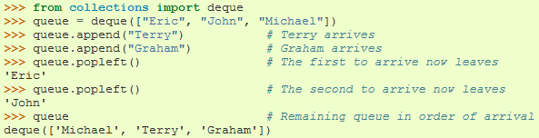
Using Lists as Queues
First element added is the first element retrieved
To do this collections.deque must be implemented

Slide 26

List Programming Tools
Filter(function, sequence)
Returns a sequence consisting of the items from the sequence for which function(item) is true
Computes primes up to 25

Slide 27

Map Function
Map(function, sequence)
Calls function(item) for each of the sequence’s items
Computes the cube for the range of 1 to 11

Slide 28

Reduce Function
Reduce(function, sequence)
Returns a single value constructed by calling the binary function (function)
Computes the sum of the numbers 1 to 10

Slide 29
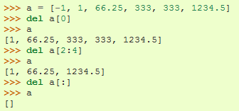
The del statement
A specific index or range can be deleted

Slide 30

Looping Techniques
Iteritems():
for retrieving key and values through a dictionary

Slide 31
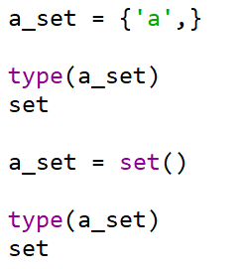
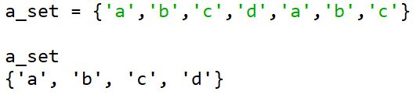
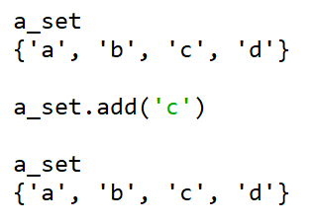
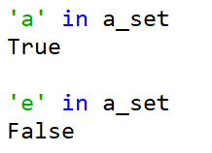
Set
Create a set
Insert into set & check membership

Slide 32
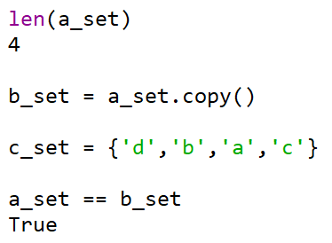
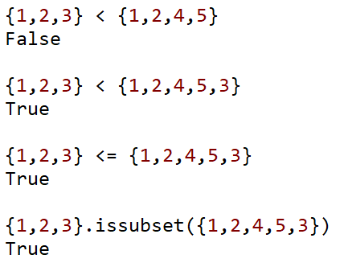
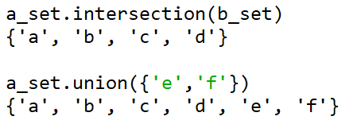
Set
Some set operations
Some more operation
Subset operations

Slide 33
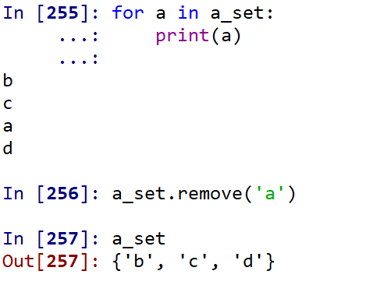
Set
Set iterating & remove

Slide 34
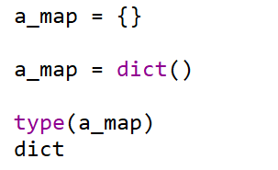
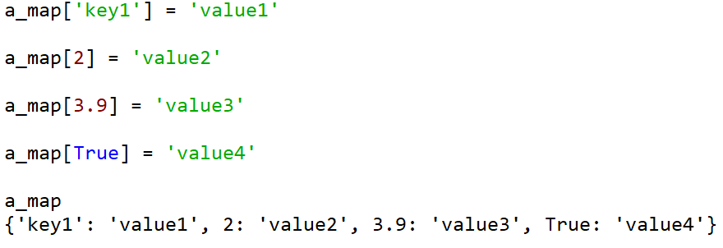
Dictionary
Creating a dictionary
Inserting elements of a dictionary

Slide 35
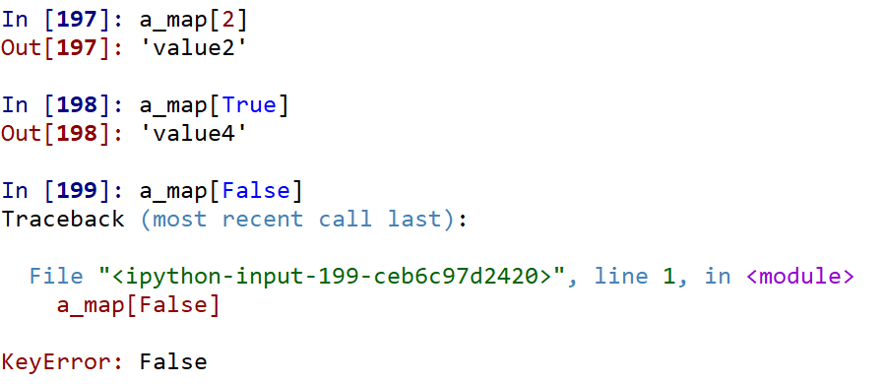

Dictionary
Accessing elements
Size of a dictionary

Slide 36
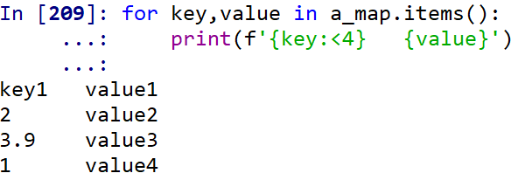
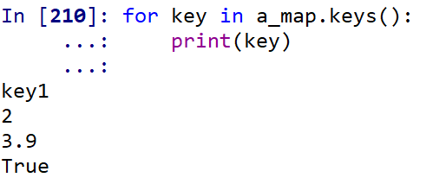
Dictionary
Iterating over dictionary
Iterating over key/values

Slide 37
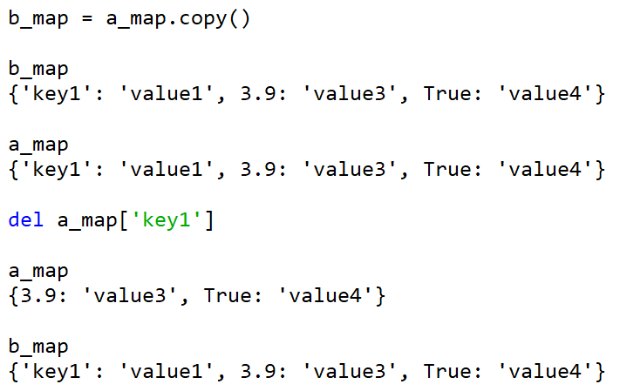
Dictionary
Copy & delete

Slide 38
Function
Defining a function
def func():
pass
Returning values
def func():
return 1
Parameters
def func(p1, p2):
pass
Default parameters
Calling a function

Slide 39
Control
Branching – if … elif … else
Looping – for & while
if False:
print("The first block of code ran")
elif True:
print("The second block of code ran")
else:
print("The third block of code ran")
for x in range(1, 11):
for y in range(1, 11):
print('%d * %d = %d' % (x, y, x*y))
x = 1
while True:
print("To infinity and beyond! We're getting close, on %d now!" % (x))
x += 1

Slide 40
Modules
Python libraries are distributed as modules
We use import module_name to import those into our source codes
If the import does not work, use pip install module_name
For example, we need to import the random module to generate random numbers
import random
random.seed(123)
r1 = random.random()
r2 = random.randint(0,10)
print(r1,' ',r2)

Slide 41
Python OOP

Slide 42
Define a class
How to define classes ?
Start with the keyword class then name of the class
Variables declared inside the class are class variable
The __init__ method is the constructor of the class
The self is the this pointer for the class
class Person:
species = 'human'
def __init__(self,name,address):
self.name = name
self.address = address

Slide 43
Using a class
Instantiate a class using the name of the class
Then access the methods/variables using instance name dot (.) the methods/variables names
p = Person('John','123 main street')
p.name #prints John
p.address #print 123 main street

Slide 44
Just one constructor?
Not really
Yes, we can define only one __init__ funciton but we can overload it
What happens if we define multiple __init__ function ?
Try it on your computer
How do we overload ?
Use default arguments as None
Inside __init__ we can initialize using if…else
class Person:
species = 'human'
def __init__(self,name=None,address=None):
self.name = name
self.address = address

Slide 45
Instance attributes vs Class attributes
What will be the output of the following code
class Person:
species = 'human'
age = 20
def __init__(self,name=None,address=None):
self.name = name
self.address = address
def setAge(self,a):
self.age = a
p1 = Person()
p2 = Person()
p1.setAge(10)
p2.setAge(23)
print(p1.age)
print(p2.age)

Slide 46
Instance attributes vs Class attributes
Class variables in python are defined just after the class definition and outside of any methods
Unlike class variables, instance variables should be defined within methods
class SomeClass: variable_1 = “ This is a class variable” variable_2 = 100 #this is also a class variable
class SomeClass: variable_1 = “ This is a class variable” variable_2 = 100 #this is also a class variable. def __init__(self, param1, param2): self.instance_var1 = param1 #instance_var1 is a instance variable self.instance_var2 = param2 #instance_var2 is a instance variable

Slide 47
Instance, Class, and Static methods
Just as there are instance and class variables, there are instance, class, and static methods
These are intended to set or get status of the relevant class or instance
So the purpose of the class methods is to set or get the details (status) of the class
Purpose of instance methods is to set or get details about instances (objects)
Static methods are different – used for grouping methods

Slide 48
Instance, Class, and Static Methods
Let’s begin by writing a class that contains simple examples for all three method types
class MyClass: def method(self): return 'instance method called', self @classmethod def classmethod(cls): return 'class method called', cls @staticmethod def staticmethod(): return 'static method called'

Slide 49
Instance method
The first method on MyClass, called method, is a regular instance method
That’s the basic, no-frills method type we use most of the time
The method takes one parameter, self, which points to an instance of MyClass when the method is called (but of course instance methods can accept more than just one parameter)
Through the self parameter, instance methods can freely access attributes and other methods on the same object
This gives them a lot of power when it comes to modifying an object’s state.
Instance methods can also access the class itself through the self.__class__ attribute
This means instance methods can also modify class state

Slide 50
Class melthod
Instead of accepting a self parameter, class methods take a cls parameter that points to the class—and not the object instance—when the method is called
Because the class method only has access to this cls argument, it can’t modify object instance state
That would require access to self
However, class methods can still modify class state that applies across all instances of the class.

Slide 51
Static method
The third method, MyClass.staticmethod was marked with a @staticmethod decorator to flag it as a static method
This type of method takes neither a self nor a cls parameter (but of course it’s free to accept an arbitrary number of other parameters)
Therefore a static method can neither modify object state nor class state
Static methods are restricted in what data they can access - and they’re primarily a way to namespace your methods

Slide 52
Static method vs Class method
The difference between a static method and a class method is:
Static method knows nothing about the class and just deals with the parameters.
Class method works with the class since its parameter is always the class itself.
Static methods have very limited use case, because like class methods or any other methods within a class, they cannot access properties of the class itself
However, when we need a utility function that doesn't access any properties of a class but makes sense that it belongs to the class, we use static functions/methods

Slide 53
Inheritance in python
Child classes override or extend the functionality (e.g., attributes and behaviors) of parent classes
In other words, child classes inherit all of the parent’s attributes and behaviors but can also specify different behavior to follow
The most basic type of class is an object, which generally all other classes inherit as their parent
When define a new class, Python 3 implicitly uses object as the parent class

Slide 54
Parent/Child concept example
Let’s say we have a general Bank_account parent class that has Personal_account and Business_account child classes
Many of the methods between personal and business accounts will be similar, such as methods to withdraw and deposit money, so those can belong to the parent class of Bank_account
The Business_account subclass would have methods specific to it, including perhaps a way to collect business records and forms, as well as an employee_identification_number variable
Similarly a Rectangle/Square/Triangle is a special case of a Polygon
All of them have area/sides
But different formula to calculate area, etc.

Slide 55
Inheritance example: Example parent class
class Polygon: def __init__(self, no_of_sides): self.n = no_of_sides self.sides = [0 for i in range(no_of_sides)] def inputSides(self): self.sides = [float(input("Enter side "+str(i+1)+" : ")) for i in range(self.n)] def dispSides(self): for i in range(self.n): print("Side",i+1,"is",self.sides[i])

Slide 56
The child class
We define Triangle which is a special Polygon
Triangle inherits the Polygon methods and define a new one
The inherited methods need not be redefined
class Triangle(Polygon): def __init__(self): Polygon.__init__(self,3) # calling super __init__ # OR super.__init__(3) def findArea(self): a, b, c = self.sides # calculate the semi-perimeter s = (a + b + c) / 2 area = (s*(s-a)*(s-b)*(s-c)) ** 0.5 print('The area of the triangle is %0.2f' %area)

Slide 57
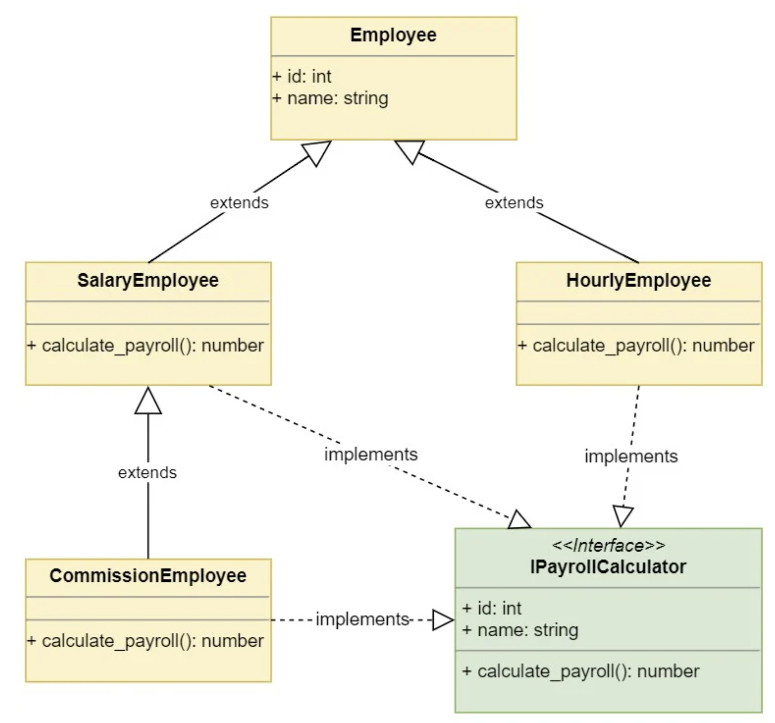

Slide 58
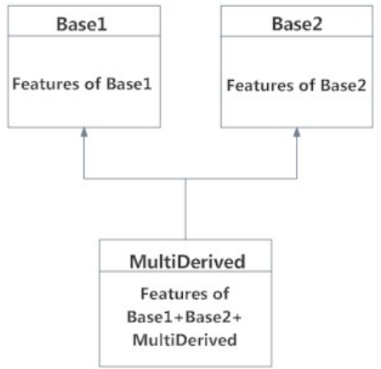
Multiple Inheritance
In multiple inheritance, the features of all the base classes are inherited into the derived class
The syntax for multiple inheritance is similar to single inheritance
class Base1: pass class Base2: pass class MultiDerived(Base1, Base2): pass

Slide 59
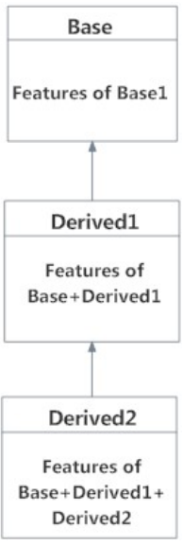
Multilevel Inheritance
On the other hand, we can also inherit form a derived class
This is called multilevel inheritance
It can be of any depth in Python
In multilevel inheritance, features of the base class and the derived class is inherited into the new derived class
class Base: pass class Derived1(Base): pass class Derived2(Derived1): pass

Slide 60
Operator overloading
Python operators work for built-in classes
But same operator behaves differently with different types
For example, the + operator will, perform arithmetic addition on two numbers, merge two lists and concatenate two strings
This feature in Python, that allows same operator to have different meaning according to the context is called operator overloading

Slide 61
Operator overloading
Try this code
class Point:
def __init__(self, x = 0, y = 0):
self.x = x
self.y = y
>>> p1 = Point(2,3) >>> p2 = Point(-1,2) >>> p1 + p2 Traceback (most recent call last): ... TypeError: unsupported operand type(s) for +: 'Point' and 'Point'

Slide 62
Operator overloading: Use special function
class Point:
def __init__(self, x = 0, y = 0):
self.x = x
self.y = y
def __str__(self):
return "({0},{1})".format(self.x,self.y)
def __add__(self,other):
x = self.x + other.x
y = self.y + other.y
return Point(x,y)

Slide 63
Operator overloading: More spefical functions
Operator | Expression | Internally
Addition | p1 + p2 | p1.__add__(p2)
Subtraction | p1 - p2 | p1.__sub__(p2)
Multiplication | p1 * p2 | p1.__mul__(p2)
Power | p1 ** p2 | p1.__pow__(p2)
Division | p1 / p2 | p1.__truediv__(p2)
Floor Division | p1 // p2 | p1.__floordiv__(p2)
Remainder (modulo) | p1 % p2 | p1.__mod__(p2)
Bitwise Left Shift | p1 << p2 | p1.__lshift__(p2)
Bitwise Right Shift | p1 >> p2 | p1.__rshift__(p2)
Bitwise AND | p1 & p2 | p1.__and__(p2)
Bitwise OR | p1 | p2 | p1.__or__(p2)
Bitwise XOR | p1 ^ p2 | p1.__xor__(p2)
Bitwise NOT | ~p1 | p1.__invert__()

